Slide 1
Adventures In Software Babysitting
How to Be a Software Development Engineer in Test
Nate Buwalda Feb. 2016

Slide 2
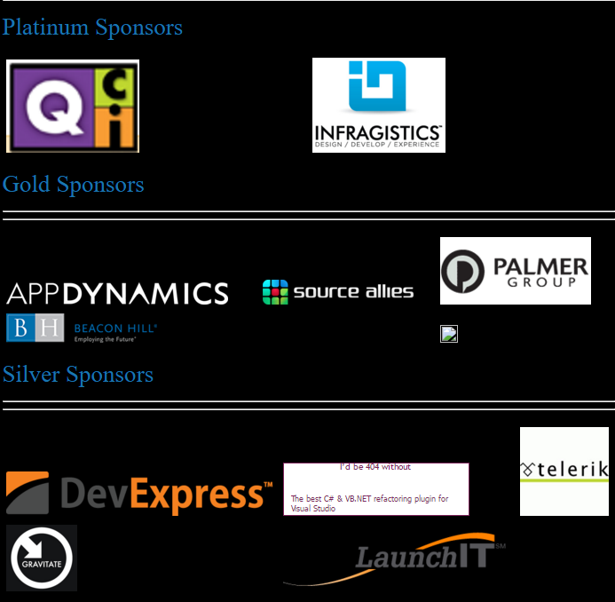
IADNUG is brought to you by…

Slide 3

What I Hope to Explain
What is a Software Development Engineer in Test?
What Types of Testing are there?
Where do SDETs fit?
What do I do with all this data?
How could this possibly go wrong?

Slide 4
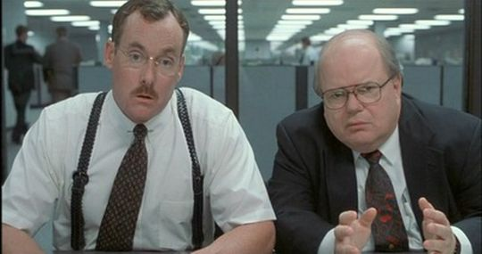
What is it you say you do here?

Slide 5
Why do we want to do this?
Because most of us write systems like this…

Slide 6
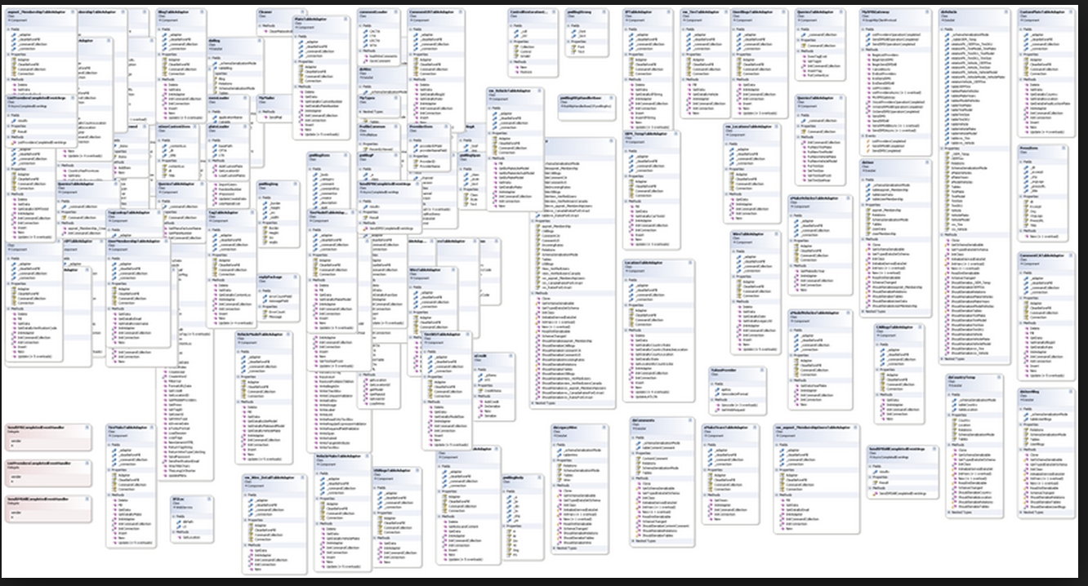
Why do we want to do this?

Slide 7
Why do we want to do this?
… and having a human test that is just cruel.

Slide 8
A Software Development Engineer in Test…
Is often abbreviated to SDET or something similar
Works in parallel to a production software team to automate high-value complex tests

Slide 9
Responsibilities of a SDET
Automation
Design and architecture
Collection and interpretation of test data
Coaching

Slide 10
A good SDET is…?
Patient
Problem-solvers
Understands system interactions
… and most of all…

Slide 11
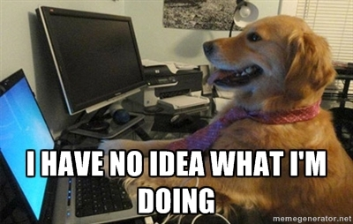
A SOFTWARE DEVELOPER!

Slide 12
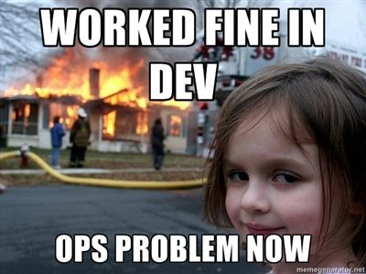
Types of Tests
If you are not writing tests now, you should be
But let’s define what sort of tests I am talking about

Slide 13
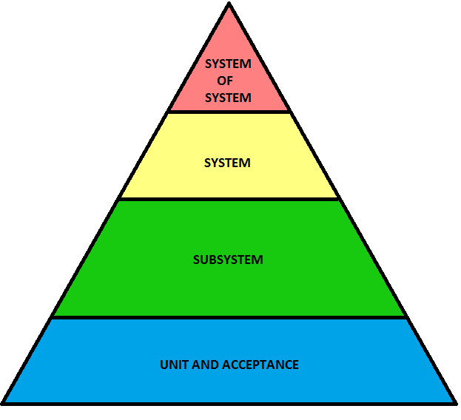
Unit & Acceptance
Tests the internal and surface interactions of your software
Do this in your software
Do not do this for other peoples’ software

Slide 14
Subsystem
Tests that the different software modules and how they communicate with each other in a system
SDETs work great here

Slide 15
System
Tests the entirety of the system and its infrastructure
SDETs work ok here
Automation here can be incredibly flakey

Slide 16
System of System
Tests the interaction of two or more coupled systems in real-world conditions
SDETs are inappropriate here

Slide 17

Where do SDETs fit?
A SDET is not…
A SDET is…

Slide 18
SDET != QA Specialist
Do not add SDETs to your team if you need a real QA team
SDETs will be focusing on their own systems
QAs and SDETs must work together

Slide 19
SDET != Manual Tester
Too expensive for this role
May not be experienced in exploratory testing

Slide 20
SDETs == Automation Design
Need to be involved in system design
How will a computer test this thing?
Will an automated test add value to this part of the system?

Slide 21
SDETs == Coaches
Help educate the organization around testing discipline
Create and manage proactive testing processes

Slide 22
SDETs == Software Developers
They make business important systems
These systems are real software
Can be thought of as another form of business intelligence

Slide 23
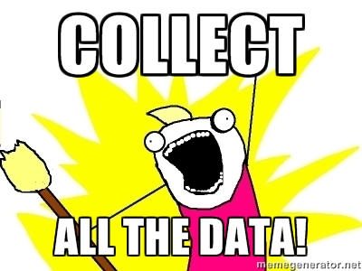
Collect All the Datas
To make a business intelligence system you need data
Testing produces data
You should store it all

Slide 24
What to Do With All This Data…?
Data generated by tests is more important to an SDET than the activity of testing
Logs
Messages, In and/or Out
Screenshots

Slide 25
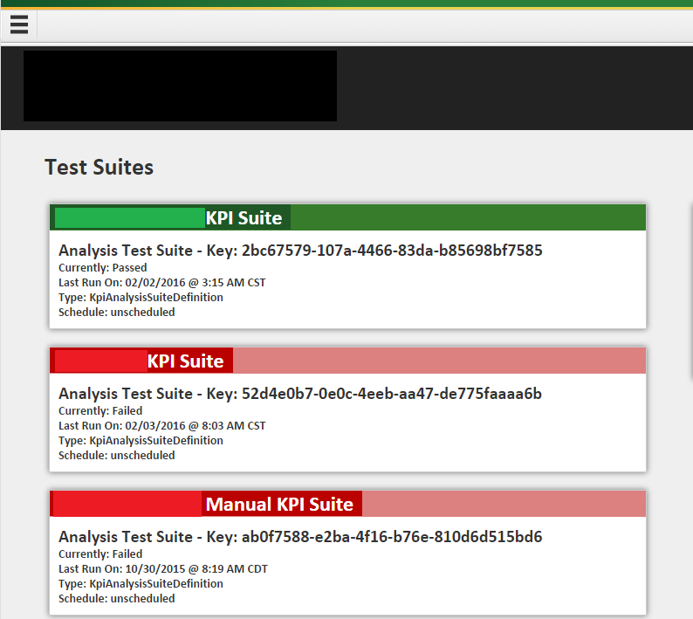
Make Big Visibles

Slide 26
Analysis and Reaction
Red test suite should indicate a significant risk to release
Gate your releases based on the condition of your suites
Create hooks for your DevOps or release team to leverage in their pipelines
Educate business people what red and green mean

Slide 27
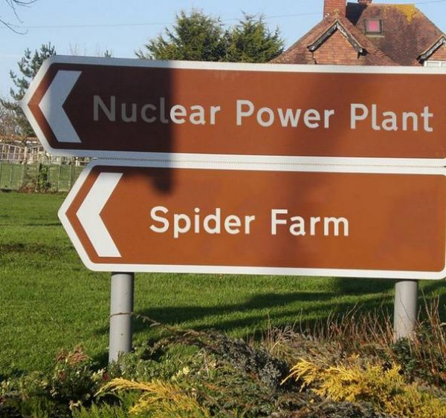
How Could this Possibly Go Wrong?
Production vs Test
Politics
Impossible Automation

Slide 28
Chasing Production’s Tail
Dealing with the Production team
Communication is important

Slide 29
Dodging Political Landmines
With great data comes great responsibility
Will have to deal with political agendas

Slide 30
No Robots Allowed
Will be asked to automate things that are not intended to be
Will be asked to automate things you are really not allowed to

Slide 31

Could be a Huge Success!
Team understands the system
Software quality improves
Customers are happy
Management is happy

Slide 32
Better Systems Understanding
You’ll better understand how the various system components work together
You’ll discover who is responsible for those various components

Slide 33
Higher Quality Systems
Discover things it would normally take hundreds of users or hours to find
Free up QA and manual testers to work on edge cases

Slide 34
Conclusions
Is it worth it? Yes.
Would you do this again? Yes.
Is this role for everyone? No.
Did it actually help? Maybe.

Slide 35
Contact Me!
@scotchnate
http://github.com/natebuwalda
natebuwalda@gmail.com
THANKS!

